Slide 1
[AI-BASED REAL-TIME PAYMENT FRAUD
DETECTION AND RISK SCORING SYSTEM]
Project Presentation Submitted
To
Dr. D. Y. Patil Vidyapeeth, Centre For Online Learning, Pune
Submitted By:
Name: [Muskan Gupta]
ERP ID: [241111591]
PRN No.: [2405020011962]
Under the Guidance of
[Vikas Kumar Atray]
[MBA]
Dr. D. Y. Patil Vidyapeeth, Centre for Online Learning, Pune
2024-2026

Slide 2
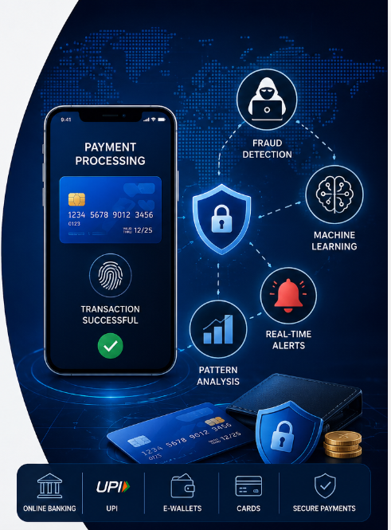





Introduction:
AI-BASED REAL-TIME PAYMENT FRAUD
DETECTION AND RISK SCORING SYSTEM
Rise of Digital Payments-The use of online banking,
mobile, UPI, cards has increased rapidly making
transaction faster , easier and more accessible.
Increasing Fraud Threats- Along with growth in
digital payment, fraudulent activities are also
increasing.
Limitations of Traditional Method-Rule- based and
manual detection system are slow and inflexible.
Role of AI and ML-ML algorithm can learn from
historical data ,detect unusual patterns in real time.
Proposed System-The system analyzed transaction
behavior, identifies potential fraud, improving
security and enhance customer trust.

Slide 3

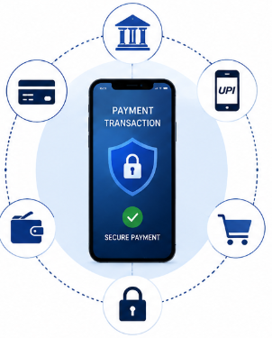












Objective, Scope, and Purpose of Study:
Objectives To develop an AI based system that can detect fraudulent digital payment transaction. To improve fraud detection performance using ML model. To analyze transaction pattern and identify suspicious activity. To generate real time alerts for fraudulent transactions.
Scope of study Applicable to online banking, cards, mobile and e-commerce payment. Handles large volume of transaction data for analysis and monitoring. Real time fraud detection and transaction monitoring capabilities. Enhances security of digital payment platform.
Purpose of study To reduce digital To improve security To build trust To minimize payment fraud. and reliability of in digital transaction. Losses for user online payment system.

Slide 4







Literature Review
Existing System-Traditional fraud detection system rely on rule based approaches and manual work
Machine Learning Approaches-Recent research shows that ML algorithm can analyze large volume
of transaction data and learn patterns automatically. These models provide higher accuracy and
adaptability for fraud detection process.
Key Findings from Previous Studies-Studies have shown that algorithms like Random Forest,
Decision tree and Logistic Regression perform better in detecting fraudulent transaction.
Real Time Fraud Detection Process-Many Researcher emphasizes the importance of real time
monitoring systems that can detect suspicious activities instantly.
Research Gap-Although various ML models, have been proposed there is still need for accurate,
real time and scalable system that can adapt to evolving fraud patterns in digital payment platform
The Literature Survey indicates that ML techniques significantly improve fraud detection accuracy.
However ,continuous improvement in data handling, model training is essential to build
more secure and reliable digital payment system.

Slide 5










SYSTEM DESIGN
The proposed system uses ML techniques to detect digital payment
transactions.
It collects transaction data, preprocess it, trains ML models, and predicts
whether a transaction is fraudulent or legitimate. If fraud is detected the
system generate real time alert.
System Overview
Technologies Used Python-Programming Language Flask –Web framework Pandas-Data Manipulation Numpy-Numerical Operation Scikit Learn-Machine Learning Matplotlib-Data Visualization
System Architecture
Workflow Diagram
To develop an efficient and real time fraud detection system that ensure secure digital payment and improves trust in digital payment.

Slide 6


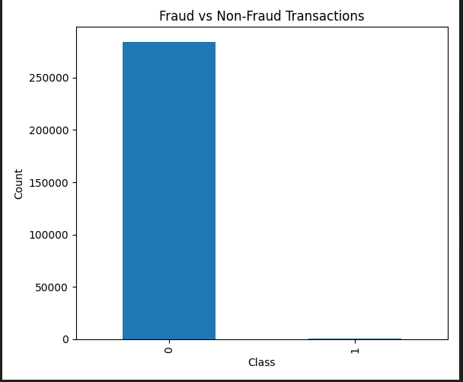


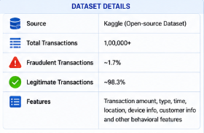


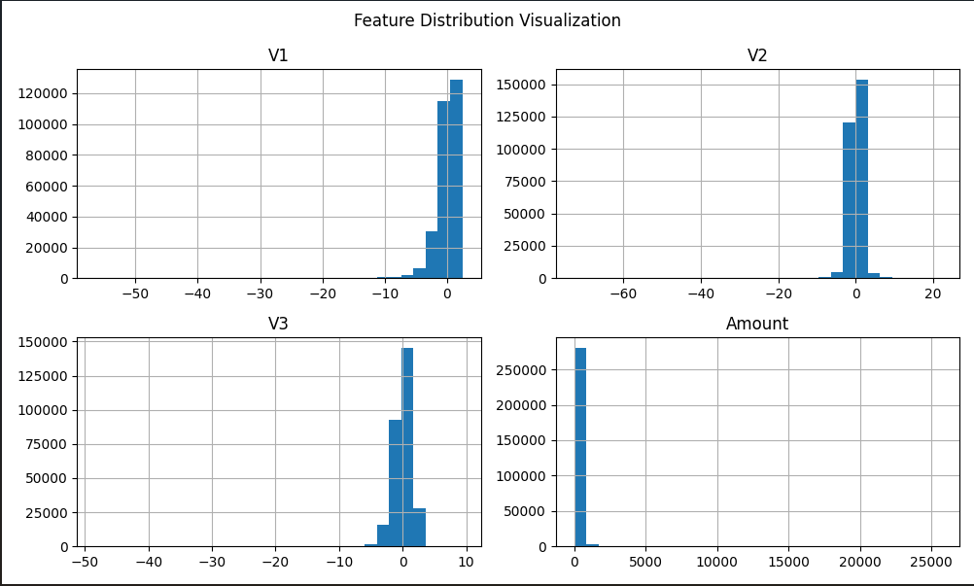
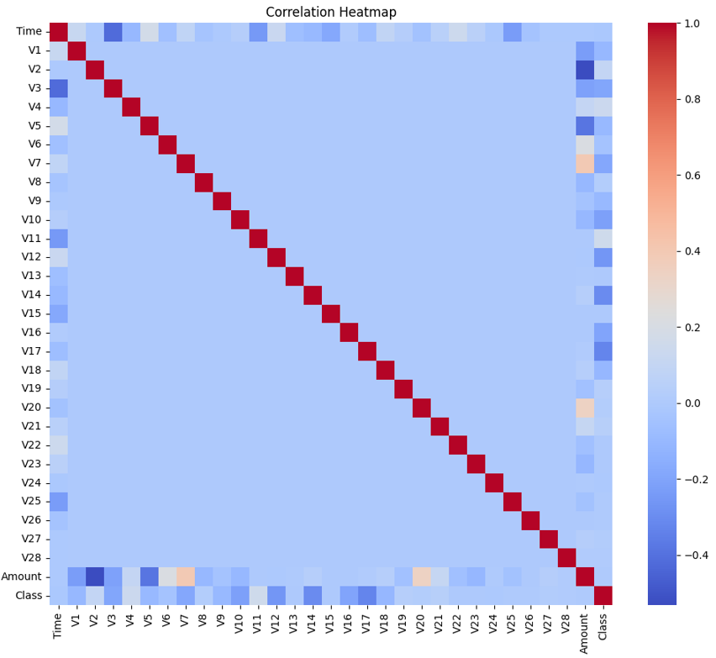



Data Collection and Analysis
Data Collection The dataset used in the study contains digital payment transaction collected from open-source repositories.
Data Preprocessing Data Cleaning-Removed Duplicate Record and handle Error. Handling Missing Values- Imputed missing values by mean, median and mode. Feature Scaling-Applied Standard scaler for normalization. Encoding Categorical Data- Converted categorical into numerical values.
Exploratory Data Analysis
Feature Analysis Identified high features that have high impact on fraud detection. Correlation analysis was performed to remove highly correlated features. Selected feature improves model accuracy and overfitting.

Slide 7

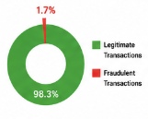
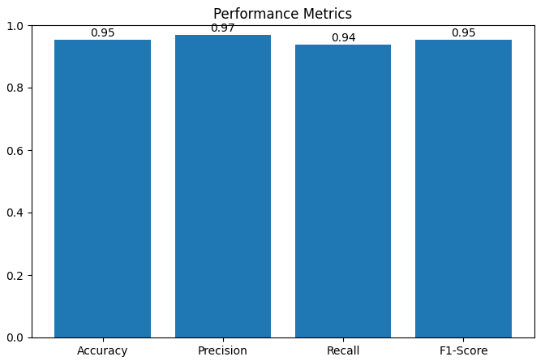








Findings and Interpretation
Dataset Overview The dataset is highly imbalanced. Fraudulent transaction are very less compared to legitimate Transaction.
Model Performance Summary
Key Findings High Accuracy-The Random Forest Model indicated highest accuracy. Low False Positive-Precision shows that system has low rate of false alerts. Imbalanced Data Handling-SMOTE and other processing techniques helped the model to learn pattern effectively from imbalanced data. Real time Potential-The system is capable of analyzing transaction in real time.
Interpretation The model effectively learns pattern of normal fraudulent transactions. High value transaction and uncommon devices contribute to fraud. Machine Learning improves detection compare to Rule based approach. Real time alerts and monitoring improves security.

Slide 8










Conclusions
.
Summary of the study The proposed system uses ML techniques to detect fraudulent digital payment transaction in real time. The model successfully detects unusual patterns in transaction such as high amount, rare location. Techniques like handling missing values, encoding, scaling and SMOTE improved model. Machine Learning based detection outperforms rule-based system in terms of adaptability.
Conclusion The AI Based Digital Payment Fraud Detection System is effective in identifying fraudulent transaction with high accuracy and reliability. The system enhances payment security and build customer trust in digital payment platforms.
Key Outcomes Accurate detection of fraudulent transaction using ML Algorithms. Reduce False Alarms and improve system efficiency. The system is scalable and can handle large volume of transactions.
Future Scope and Suggestions Deep Learning Real time Biometric Continuous Models integration Authentication Learning

Slide 9
References
Kaggle Fraud Detection Dataset
Sci-kit Learn Documentation
Pandas Documentation
Numpy Documentation
Flask Framework Documentation
Matplotlib Documentation
Hands-On Machine Learning with Scikit-Learn, Keras, and TensorFlow,O’Reilly Media
Python for Data Analysis, O’Reilly Media, 2022
Introduction to Machine Learning with Python, O’Reilly Media, 2016
Postman

Slide 10
THANK YOU

